Slide 1

Graphic Arts Merit Badge
Troop 344 and 9344
Pemberville, OH

Slide 2
Requirements
Review with your counselor the processes for producing printed communications: offset lithography, screen printing, electronic/digital, relief, and gravure. Collect samples of three products, each one produced using a different printing process, or draw diagrams to help with your description.
Explain the differences between continuous tone, line, and halftone artwork. Describe how digital images can be created and/or stored in a computer.
Design a printed piece (flier, T-shirt, program, form, etc.) and produce it. Explain your decisions for the typeface or typefaces you use and the way you arrange the elements in your design. Explain which printing process is best suited for printing your design. If desktop publishing is available, identify what hardware and software would be appropriate for outputting your design.

Slide 3
Requirements
Produce the design you created for requirement 3 using one of the following printing processes:
  Offset lithography
  Make a layout and produce a plate using a process approved by your counselor. Run the plate and print at least 50 copies.
  Screen printing
  Make a hand-cut or photographic stencil and attach it to a screen that you have prepared. Mask the screen and print at least 20 copies.
  Electronic/digital printing
  Create a layout in electronic form, download it to the press or printer, and run 50 copies. If no electronic interface to the press or printer is available, you may print and scan a paper copy of the layout.
  Relief printing
  Prepare a layout or set the necessary type. Make a plate or lock up the form. Use this to print 50 copies.

Slide 4
Requirements
Review the following postpress operations with your counselor:
  Discuss the finishing operations of padding, drilling, cutting, and trimming.
  Collect, describe, or identify examples of the following types of binding: perfect, spiral, plastic comb, saddle stitched, and case.
Do ONE of the following, then describe the highlights of your visit:
  Visit a newspaper printing plant: Follow a story from the editor to the press.
  Visit a retail, commercial, or in-plant printing facility: Follow a project from beginning to end.
  Visit a school's graphic arts program: Find out what courses are available and what the prerequisites are.
  Visit three websites (with your parent's permission) that belong to graphic arts professional organizations and/or printing-related companies (suppliers, manufacturers, printers): With permission from your parent or counselor, print out or download product or service information from two of the sites.

Slide 5
Requirements
Find out about three career opportunities in graphic arts. Pick one and find out the education, training, and experience required for this profession. Discuss this with your counselor, and explain why this profession might interest you.

Slide 6
Requirement 1
Review with your counselor the processes for producing printed communications: offset lithography, screen printing, electronic/digital, relief, and gravure. Collect samples of three products, each one produced using a different printing process, or draw diagrams to help with your description.

Slide 7
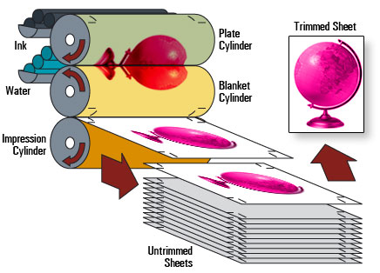
Requirement 1
Offset printing, also called offset lithography, is a method of mass-production printing in which the images on metal plates are transferred (offset) to rubber blankets or rollers and then to the print media. The print media, usually paper, does not come into direct contact with the metal plates.

Slide 8
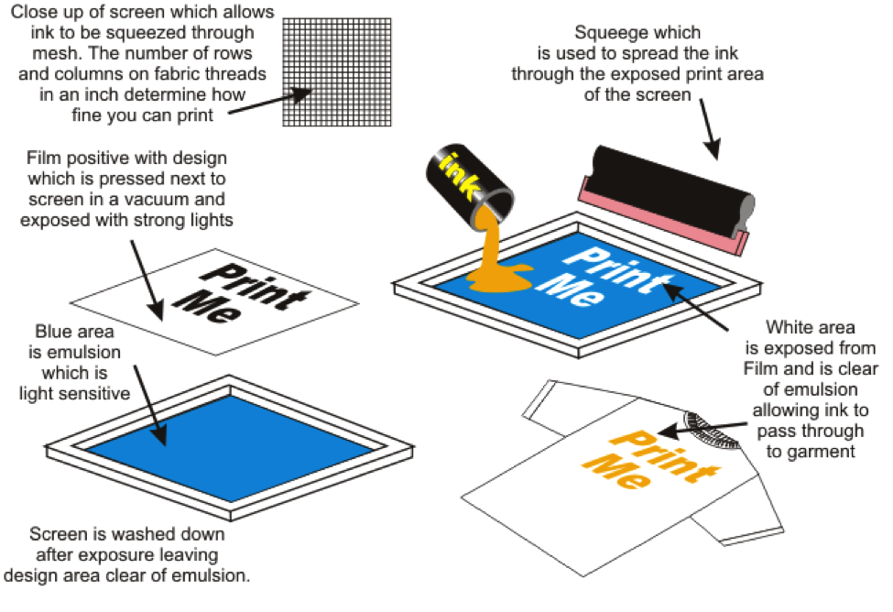
Requirement 1
Screen printing is a printing technique where a mesh is used to transfer ink onto a substrate, except in areas made impermeable to the ink by a blocking stencil.

Slide 9
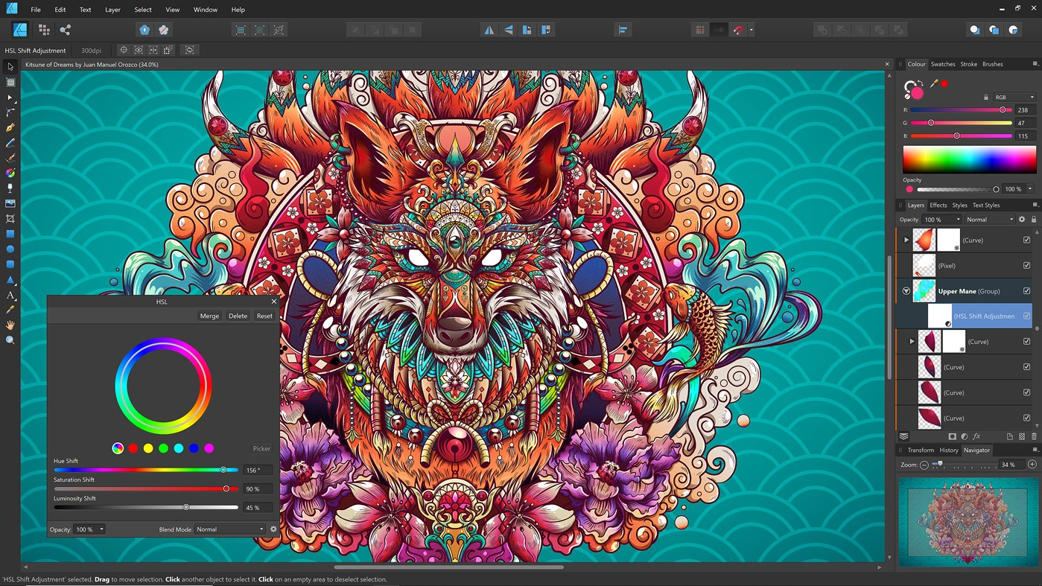
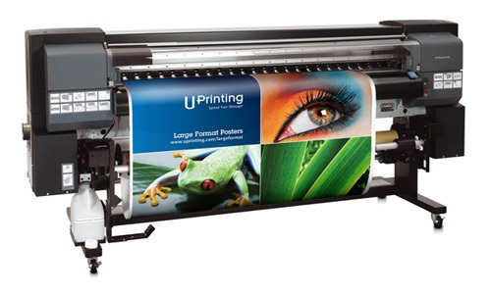
Requirement 1
Digital printing is a modern method of production that makes prints from electronic files. It involves your artwork being created on a computer and then printed directly onto the material of your choice.

Slide 10
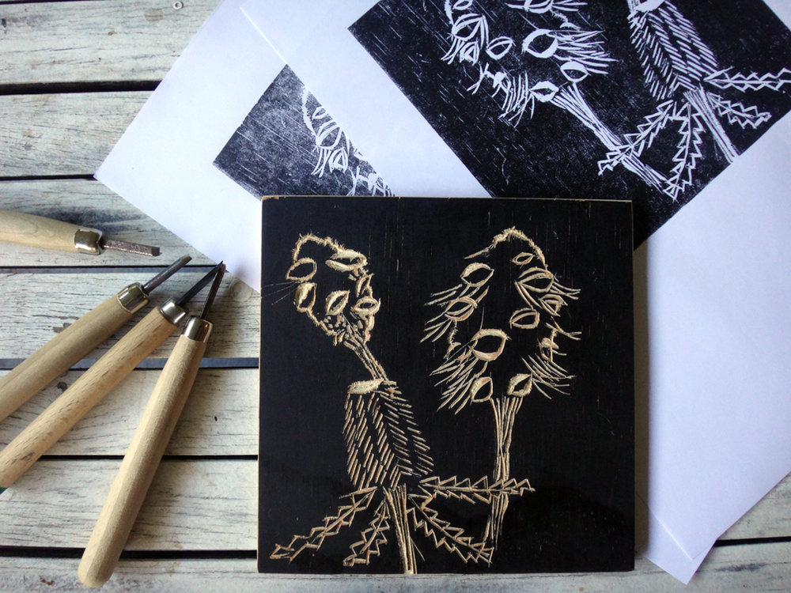
Requirement 1
Relief printing is a process consisting of cutting or etching a printing surface into a block, plate, or matrix in such a way that all that remains of the original surface is the design to be printed. The printing block, plate, or matrix has ink applied to its surface, but not to any recessed areas, is then brought into contact with paper.

Slide 11
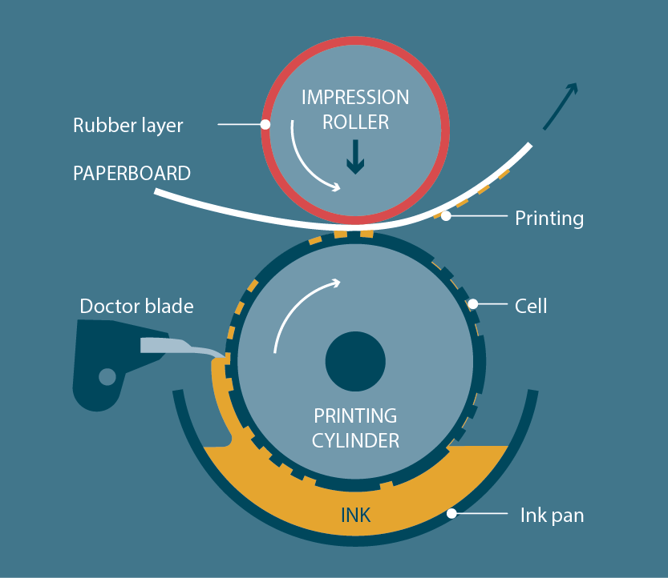
Requirement 1
Rotogravure – gravure for short – is a type of intaglio printing process in which the image is engraved onto a cylinder because, like offset printing, it uses a rotary printing press.

Slide 12
Requirement 2
Explain the differences between continuous tone, line, and halftone artwork. Describe how digital images can be created and/or stored in a computer.

Slide 13
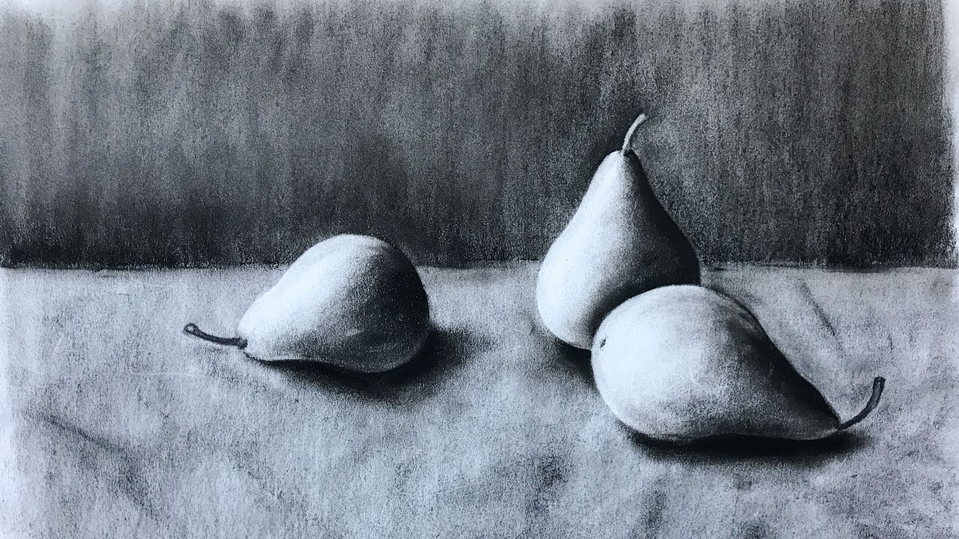
Requirement 2
Continuous Tone Artwork - Image in which colors and shades of gray smoothly merge into the neighboring colors or shades, instead of producing distinct, sharply-outlined areas of color or shade.

Slide 14
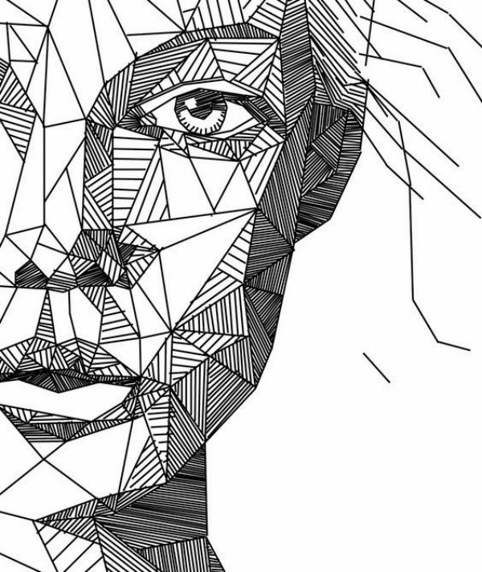
Requirement 2
Line Artwork - is any image that consists of distinct straight or curved lines placed against a background, without gradations in shade or hue to represent two-dimensional or three-dimensional objects. Line art can use lines of different colors, although line art is usually monochromatic.

Slide 15
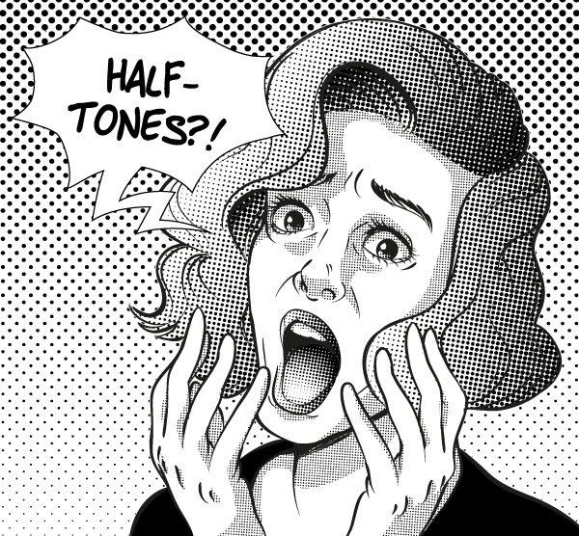
Requirement 2
Halftone Artwork - is artwork comprised of discrete dots rather than continuous tones. When viewed from a distance, the dots blur together, creating the illusion of continuous lines and shapes.

Slide 16
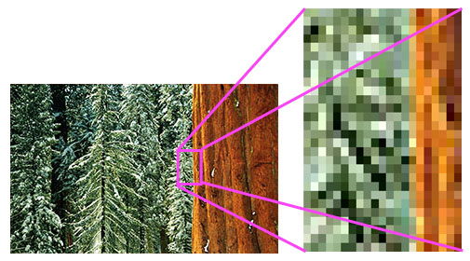
Requirement 2
A digital image is a representation of a real image as a set of numbers that can be stored and handled by a digital computer. In order to translate the image into numbers, it is divided into small areas called pixels (picture elements). For each pixel, the imaging device records a number, or a small set of numbers, that describe some property of this pixel, such as its brightness (the intensity of the light) or its color. The numbers are arranged in an array of rows and columns that correspond to the vertical and horizontal positions of the pixels in the image.

Slide 17
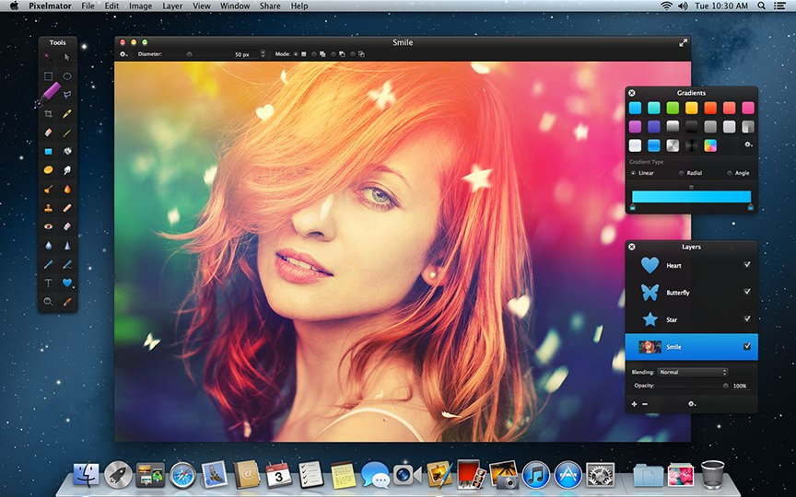
Requirement 2
An advantage of a digital image is the ability to change them according to one's needs. There are several programs available now which give a user the ability to do that, including Photoshop, Photopaint, and Gimp. With such a program, a user can change the colors and brightness of an image, delete unwanted visible objects, move others, and merge objects from several images, among many other operations. In this way a user can retouch family photos or even create new images.

Slide 18
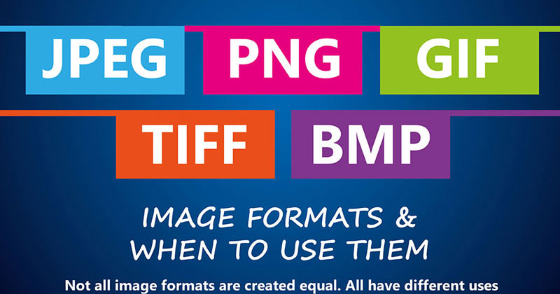
Requirement 2
Computer-generated images can be stored in several different formats and differing resolutions. But all computer files, whether numbers, words or graphics, are stored as digital information. What computers do is translate the image into digital code for storage and then interpret the file back into an image for display. How the computer does this involves the manner in which the image was created and the code and formats needed for making a graphic image file and then creating a graphic image display.
Computers store graphic information in several formats.

Slide 19
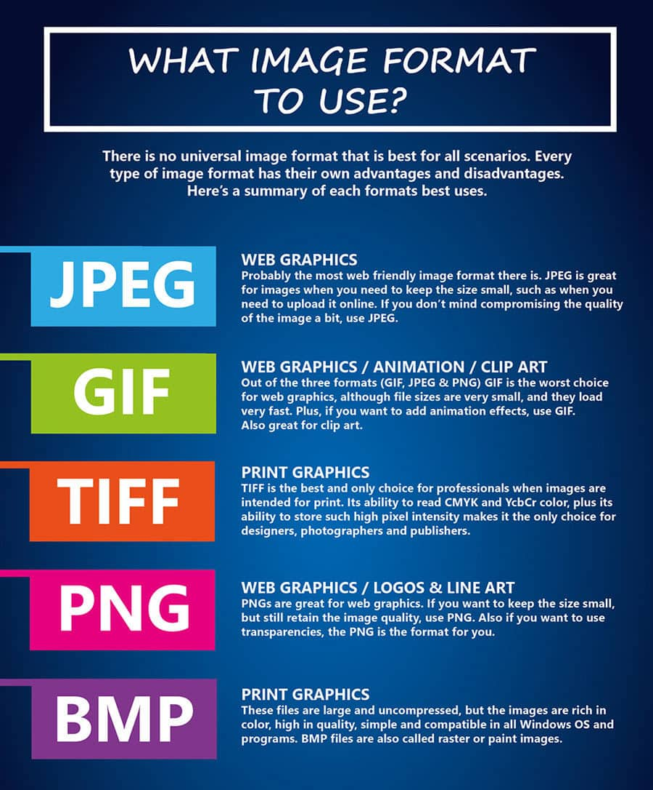

Slide 20
Requirement 3
Design a printed piece (flier, T-shirt, program, form, etc.) and produce it. Explain your decisions for the typeface or typefaces you use and the way you arrange the elements in your design. Explain which printing process is best suited for printing your design. If desktop publishing is available, identify what hardware and software would be appropriate for outputting your design.

Slide 21
Requirement 3
Every printing job requires planning
  What type of job it is and what the finished piece is expected to be.
  Which printing process is best for the job.
A printing job can be broken into two parts:
  The design includes how you will communicate your message and what that message will look like.
    The design elements are the words and pictures of your design.
  The layout is when you assemble all of the elements of your design to make a master (completed version) that will be the basis of what you will be printing.
  The printing process you plan to use and the equipment you have available will determine the way you assemble your layout.

Slide 22
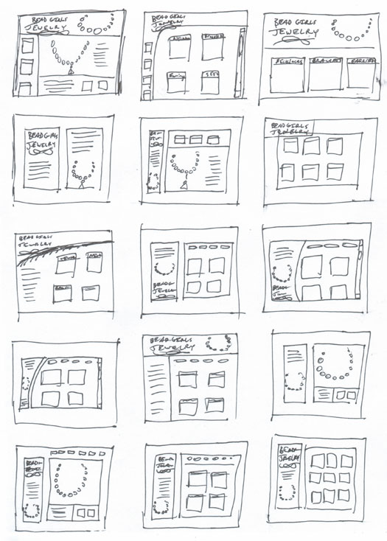
Requirement 3
Step 1 - The Thumbnail
A thumbnail is a simple pencil drawing of your design idea usually smaller than the size you plan.
It mainly shows proportion and the shape of the piece with the design elements drawn as basic geometric shapes.
Make more than one thumbnail sketch inventing different ideas.
This will give you several ideas to choose from and help you create the best possible design.

Slide 23
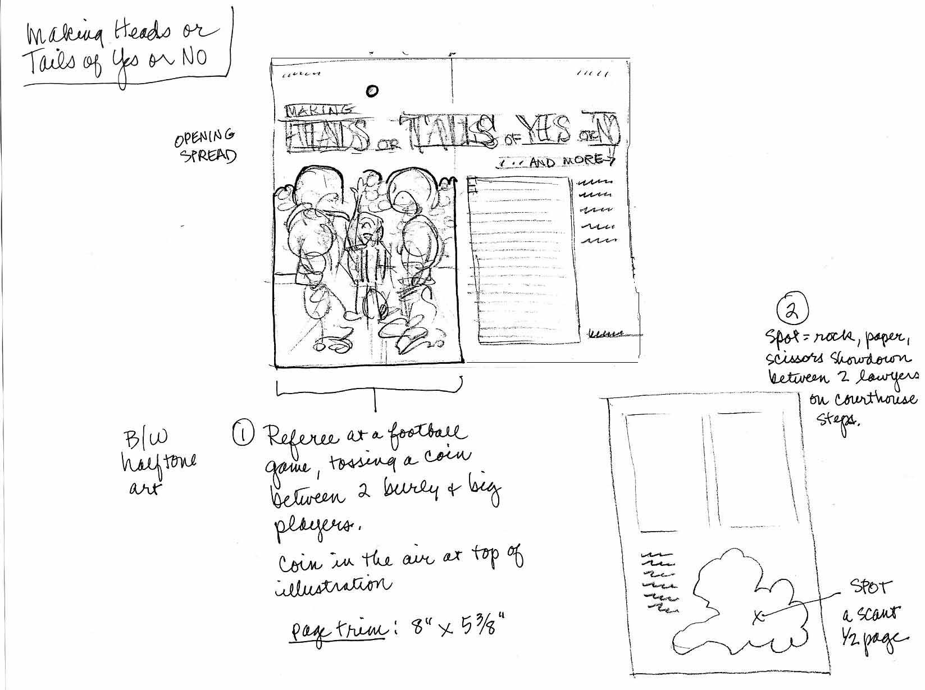
Requirement 3
Step 2 – The Rough
Choose your favorite thumbnail and expand on that design.
A rough is drawn the actual size of the planned piece and it shows the design elements in greater detail than the thumbnail.
Draw the larger words in the style and size they will be printed.
Show long paragraphs as a series of lines.
Pictures in the design should depict minimum details.
Write notes off to the side of the rough to indicate the sizes and styles of the type and any picture’s format and source.
Write these notes in a color different from the color you for design elements.

Slide 24
Requirement 3
Choosing Typefaces
Each type classification is generally suited for a particular purpose.
  Roman type is usually used for books, newspapers, magazines, or any printing where there is a lot of continuous reading.
  Sans serif type is typically found in headlines or titles.
  Text type has an “official” look and is often used for important documents such as diplomas, certificates, and legal papers.
  Script type usually projects a sense of elegance and formality and is commonly used for wedding invitations or where a carefully crafted human touch is desired.
  Novelty type may be designed to look powerful, silly, exciting, or nearly any mood you want and should be used sparingly.

Slide 25
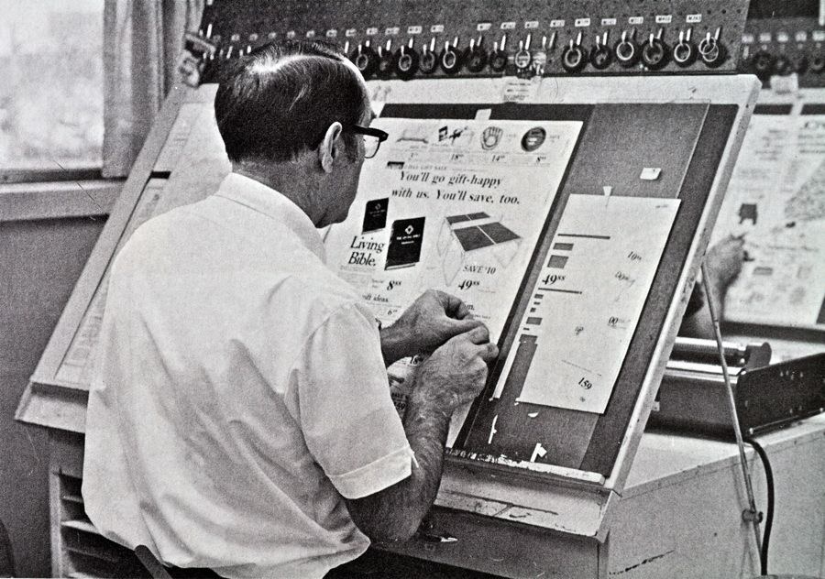
Requirement 3
Making the Layout
Paste up
  The traditional, but outdated, paste up is made on a piece of heavy white paper or illustration board.
  It is called a paste up because you cut out and paste all the final text and graphics on the board according to the rough design.
  When all the text and graphics are accurately fixed in position, it is photographed with a stat camera to create a same-size film negative for each printing plate required for lithography or the negative is turned into a picture to make a photographic stencil for screen printing.

Slide 26
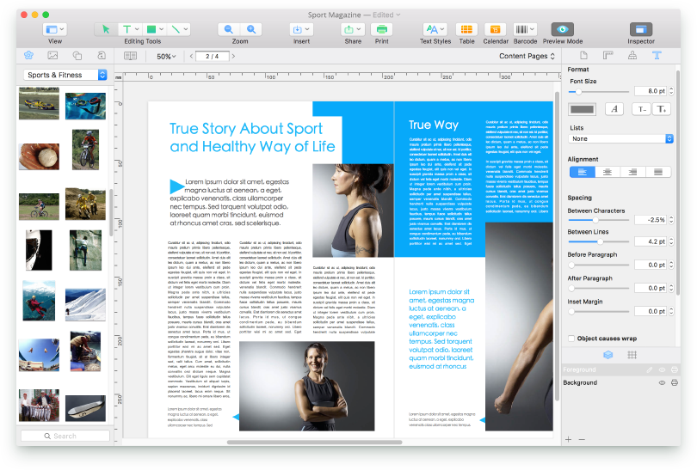
Requirement 3
Making the Layout
Most layouts today are done on computer systems using desktop publishing software.
Some tools you can use when making a layout with a computer:
  Use word-processing software to set type for text.
  Create graphics with painting or drawing software.
  Use computer clip art.
  Scan your photographs or artwork to a computer.
  Download text and graphics from the internet.
  Take photos with a digital camera or your phone and download them to a computer.
After you have created your layout with a computer, print the digital paste up using a printer.

Slide 27
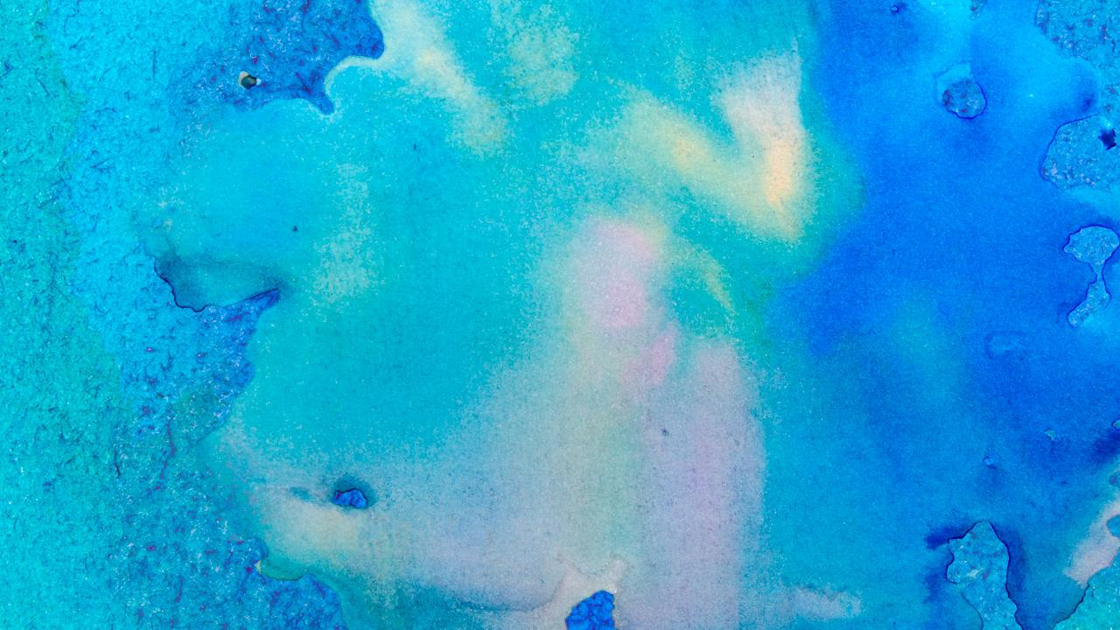
Requirement 4
Produce the design you created for requirement 3 using one of the following printing processes:
  Offset lithography
  Make a layout and produce a plate using a process approved by your counselor. Run the plate and print at least 50 copies.
  Screen printing
  Make a hand-cut or photographic stencil and attach it to a screen that you have prepared. Mask the screen and print at least 20 copies.
  Electronic/digital printing
  Create a layout in electronic form, download it to the press or printer, and run 50 copies. If no electronic interface to the press or printer is available, you may print and scan a paper copy of the layout.
  Relief printing
  Prepare a layout or set the necessary type. Make a plate or lock up the form. Use this to print 50 copies.

Slide 28
Requirement 4
You can produce your design for printing with the help of the downloadable instructions in PDF format that were provided with this presentation.
  Screen Printing at Home
  Relief Printing Woodblock Edition
  Relief Printing Linocuts Edition
You can also use a computer, graphic design software, and a printer to meet this requirement.

Slide 29
Requirement 5
Review the following postpress operations with your counselor:
  Discuss the finishing operations of padding, drilling, cutting and trimming.
  Collect, describe, or identify examples of the following types of binding: perfect, spiral, plastic comb, saddle stitched, and case.

Slide 30
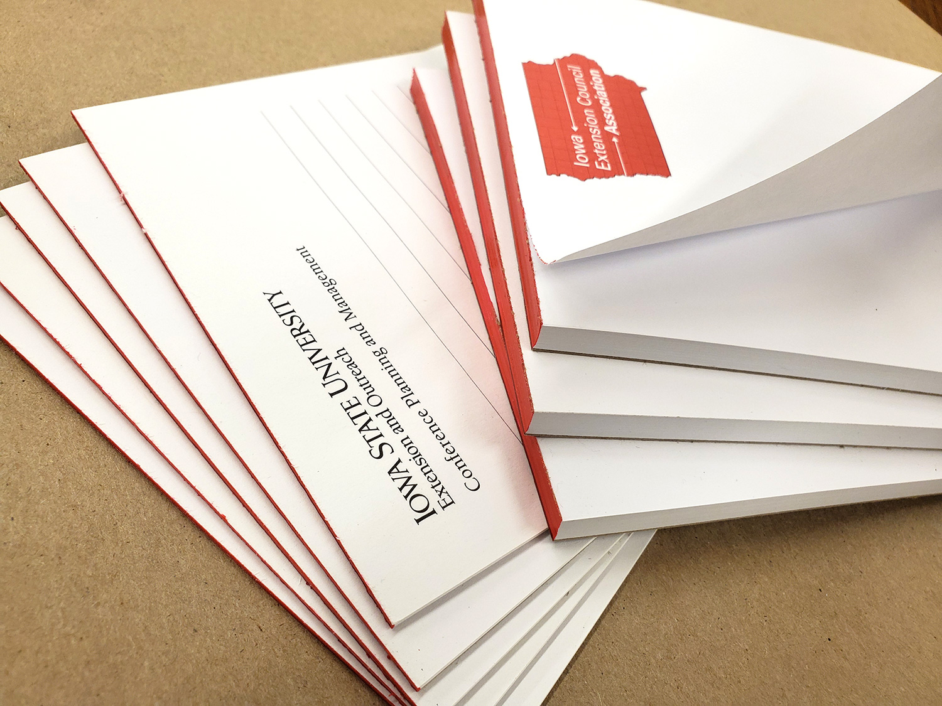
Requirement 5
Padding Finish
Refers to the binding of a stack of sheets, by using a flexible adhesive along one edge of a stack of same-sized sheets.
The adhesive secures the sheets as a unit, but allows the top sheet to be easily removed when needed.
Notepads are a typical example of padding.

Slide 31
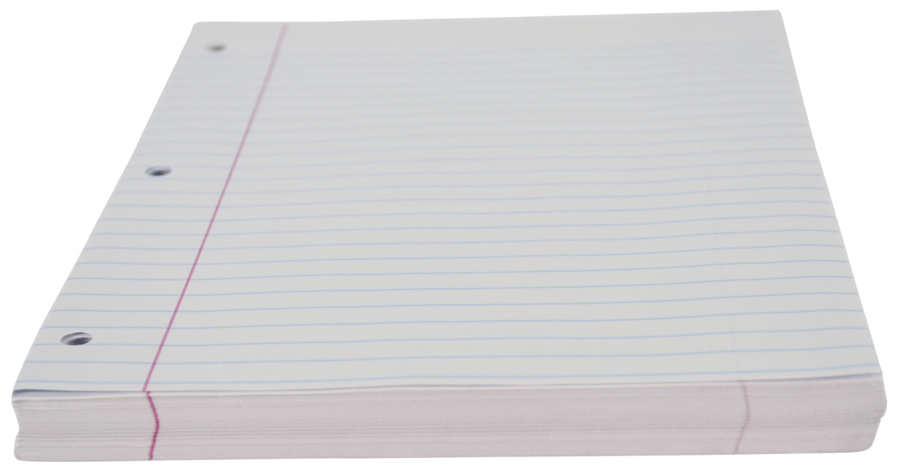
Requirement 5
Drilling
Refers to the process of creating round holes in paper using a rotating bit, such as the hole patterns needed for sheets and dividers placed into ringed binders.

Slide 32
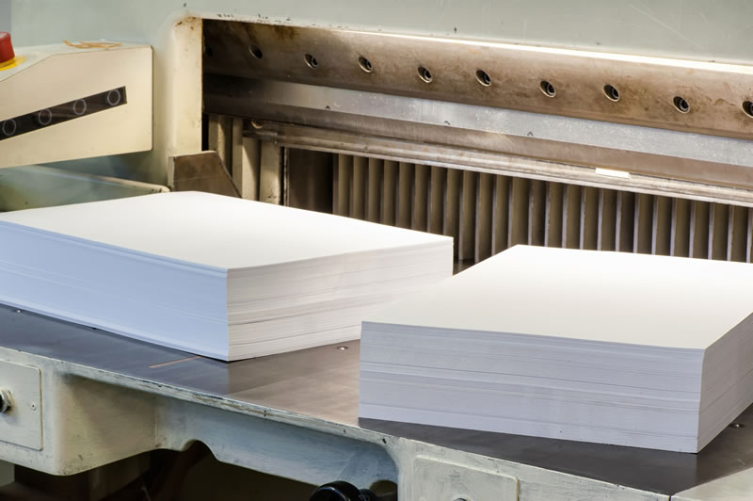
Requirement 5
Cutting and trimming
Cutting is often differentiated from trimming in that cutting refers to the separation of pages that have been printed together, while trimming refers to the process of removing paper from around the edges of a sheet.
Cutting and trimming are usually done using a guillotine cutter. A stack of sheets is placed on the bed of the cutter and the angled stainless steel blade cuts through it at the desired position.

Slide 33
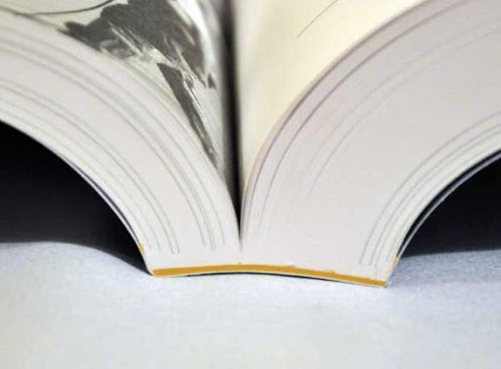
Requirement 5
Perfect Binding is a widely used soft cover book binding method.
With this binding method, the pages and cover are glued together at the spine with a strong yet flexible thermal glue.
The other three sides of the book are then trimmed as needed to give them clean “perfect” edges.

Slide 34
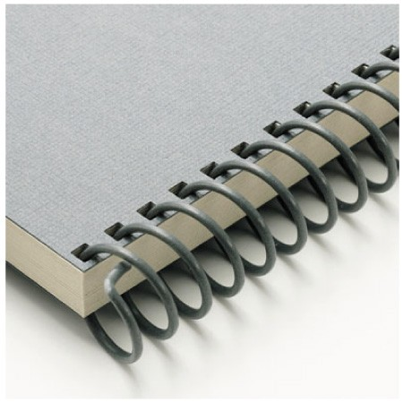
Requirement 5
Spiral binding is the process of binding pages together with a plastic coil that is inserted into holes along the edge of paper pages.
It is effective for documents up to 300 pages.
Spiral bound printing is generally used for booklets or catalogs that need to lay flat and referred to often.

Slide 35
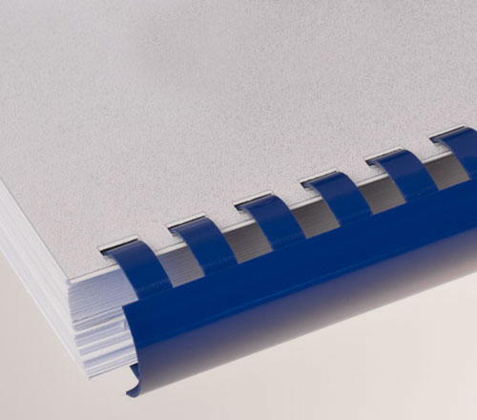
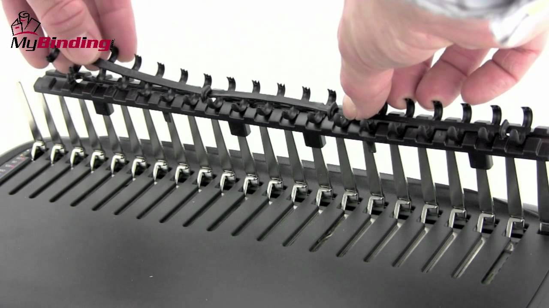
Requirement 5
Plastic Comb binding: The teeth of a plastic ‘comb’ are inserted into a series of slits drilled or punched into a stack of sheets. This process is often used for reports and presentations.

Slide 36
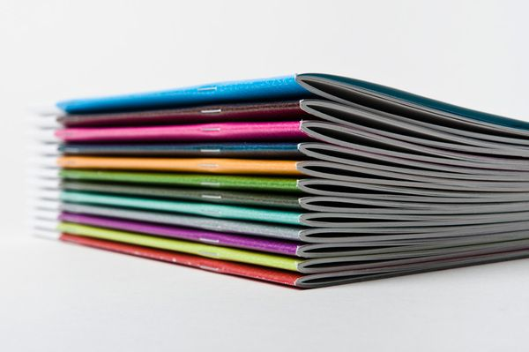
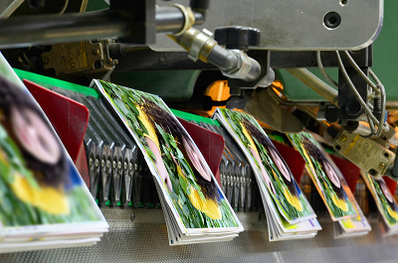
Requirement 5
Saddle stitch binding is when single sheets of paper are printed on both sides, collated in page number order, folded in half and then stapled through the fold by a saddle stitch stapler.
Saddle stitch binding is one of the most common binding methods for booklet manufacturing, magazines, newsletters, small catalogs, etc., but is limited in the number of pages that can be bound.

Slide 37

Requirement 5
Case binding - The pages of the book are arranged in signatures and sewn or stitched together in the correct page order.
A signature is a group of sheets folded in half, to be worked into the binding as a unit.
Then, hard covers made of cloth, vinyl, or leather over cardboard are attached to the book using glued-on endpapers.

Slide 38
Requirement 6
Do ONE of the following, then describe the highlights of your visit:
  Visit a newspaper printing plant: Follow a story from the editor to the press.
  Visit a retail, commercial, or in-plant printing facility: Follow a project from beginning to end.
  Visit a school's graphic arts program: Find out what courses are available and what the prerequisites are.
  Visit three websites (with your parent's permission) that belong to graphic arts professional organizations and/or printing-related companies (suppliers, manufacturers, printers): With permission from your parent or counselor, print out or download product or service information from two of the sites.

Slide 39


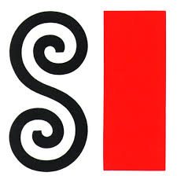

Requirement 6
American Institute of Graphic Arts (AIGA)
Graphic Artists Guild
Society of Illustrators
Bowling Green State University Graphic Design Program

Slide 40
Requirement 7
Find out about three career opportunities in graphic arts. Pick one and find out the education, training, and experience required for this profession. Discuss this with your counselor, and explain why this profession might interest you.

Slide 41
Requirement 7
Graphic Designer Career, Salary and Education Information
What They Do: Graphic designers create visual concepts, using computer software or by hand, to communicate ideas that inspire, inform, and captivate consumers.
Work Environment: Many of these workers are employed in specialized design services, publishing, or advertising, public relations, and related services industries.
How to Become One: Graphic designers usually need a bachelor’s degree in graphic design or a related field. Candidates for graphic design positions should have a portfolio that demonstrates their creativity and originality.
Salary: The median annual wage for graphic designers in 2020 is $50,370.
Job Outlook: Employment of graphic designers is projected to grow 3 percent over the next ten years, slower than the average for all occupations. Graphic designers are expected to face strong competition for available positions.

Slide 42
Requirement 7
Career Opportunities in Graphic Arts
Graphic Designer
The designer plans the piece to be printed and establishes the theme and style of the printed piece. Materials are created utilizing computerized design tools and programs. Designers should have a natural artistic talent as well as an eye for detail and color.
Photographer/Videographer
The photographer produces the images required for a variety of reproduction including websites, catalogs, brochures, billboards, books and advertising materials. Both static and moving video imaging are part of this position. Photographers must have proven creative talent, as well as the ability to get along with others during a photo shoot. Due to the use of digital cameras, photographers must be familiar with digital and computer technologies.
Illustrator
The illustrator creates illustrations, drawings, charts, graphs, or full-color artwork to complement the written word. Most illustrations are now created using computerized software programs. However, an illustrator must still have precise artistic talent as well as a knowledge of composition and proper use of the tools of the craft.

Slide 43
Requirement 7
Career Opportunities in Graphic Arts
Page-layout Artist
The page-layout artist uses a computer workstation to assemble the artwork and the text according to the designer’s layout. Since the artist prepares the piece for production, the job requires precision, accuracy, neatness, and the ability to follow directions. With modern software systems in use, one person often performs all the functions of the graphic designer, illustrator, and page-layout artist. Therefore, the person needs a well-rounded knowledge of computer software, in addition to having artistic ability.
Social Media/Web Specialist
Many projects are distributed by a variety of channels and print/mail is often coordinated with web based methods. The specialist may coordinate e-blasts, manage database files, update websites and other tasks related to electronic communications with clients.

